Slide 1
Quantum Arithmetic for Finance
https://youtu.be/h6pH4GYs-s8

Slide 2
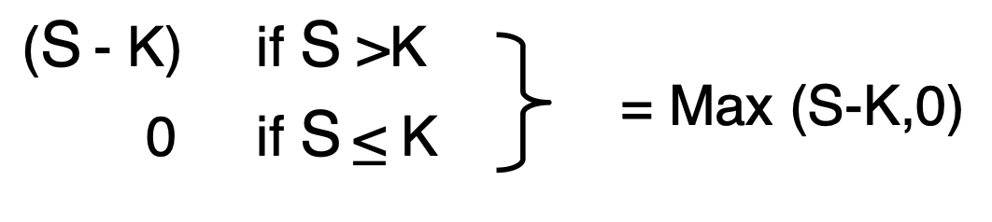
Arithmetic for Finance
• f_k(s) = max (s – k, 0)
• g(x) = max (S_0 exp (\sigma x + c) – k, 0)

Slide 3
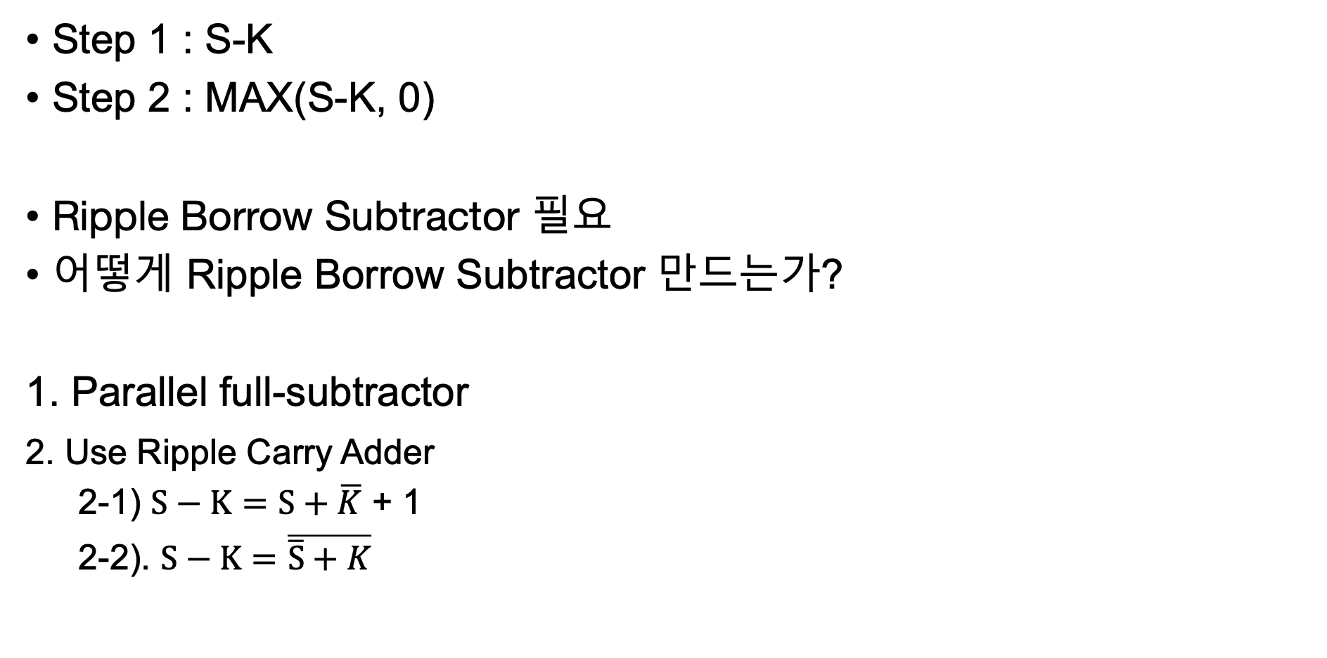
MAX(S-K,0)
Step 1 : S-K
Step 2 : MAX(S-K, 0)
Ripple Borrow Subtractor 필요
어떻게 Ripple Borrow Subtractor 만드는가?
1. Parallel full-subtractor
2. Use Ripple Carry Adder
2-1) $S−K=S+\overline{K}$ + 1
2-2). $S−K=\overline{\overline{S}+K}$

Slide 4
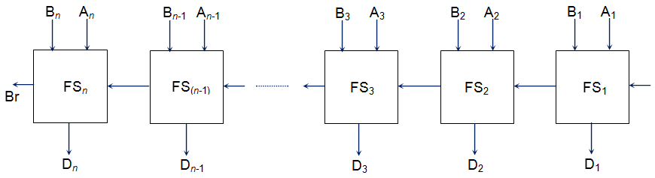





































Parallel full-subtractor
Classic
$$b_{n}$$
$$a_{n}$$
$$b_{n−1}$$
$$a_{n−1}$$
$$b_{3}$$
$$a_{3}$$
$$b_{2}$$
$$a_{2}$$
$$b_{1}$$
$$a_{1}$$
$$0$$
Quantum
$$c_{n}$$
$${ FS}_{1}$$
$$c_{n−1}$$
$${ FS}_{1}$$
$$c_{n−2}$$
$$c_{3}$$
$${ FS}_{1}$$
$$c_{2}$$
$${ FS}_{1}$$
$$c_{1}$$
$${ FS}_{1}$$
Use of extra bits to achieve reversible computation.
$$b_{n}$$
$$d_{n}$$
$$g_{n}$$
$$b_{n−1}$$
$$d_{n−1}$$
$$g_{n−1}$$
$$b_{3}$$
$$d_{3}$$
$$g_{3}$$
$$b_{2}$$
$$d_{2}$$
$$g_{2}$$
$$b_{1}$$
$$d_{1}$$
$$g_{1}$$

Slide 5
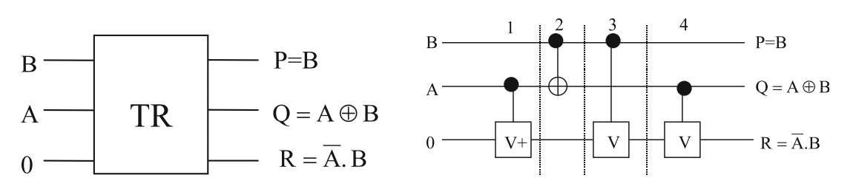
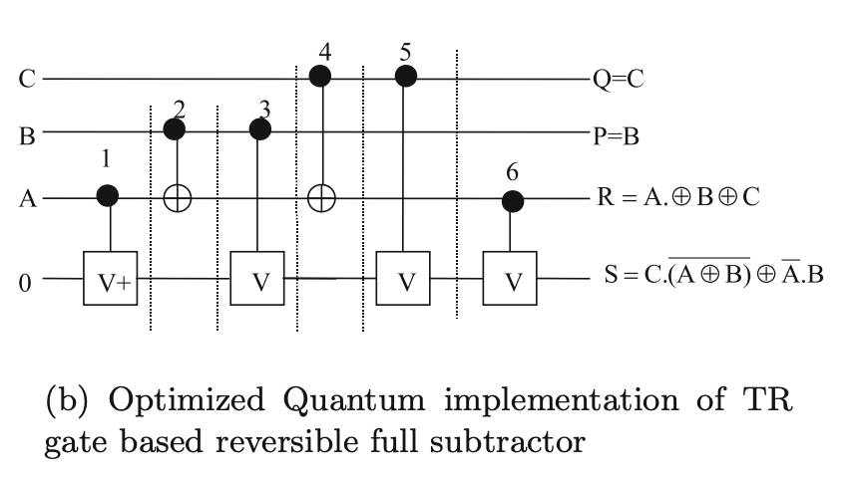










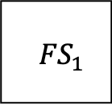
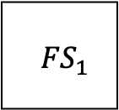








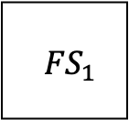







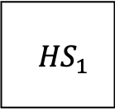






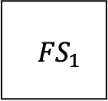

$$b_{n}$$
$$a_{n}$$
$$b_{n−1}$$
$$a_{n−1}$$
$$b_{3}$$
$$a_{3}$$
$$b_{2}$$
$$a_{2}$$
$$b_{1}$$
$$a_{1}$$
$$0$$
Quantum
$$c_{n}$$
$${ FS}_{1}$$
$$c_{n−1}$$
$${ FS}_{1}$$
$$c_{n−2}$$
$$c_{3}$$
$${ FS}_{1}$$
$$c_{2}$$
$${ FS}_{1}$$
$$c_{1}$$
$${ HS}_{1}$$
$$b_{n}$$
$$d_{n}$$
$$g_{n}$$
$$b_{n−1}$$
$$d_{n−1}$$
$$g_{n−1}$$
$$b_{3}$$
$$d_{3}$$
$$g_{3}$$
$$b_{2}$$
$$d_{2}$$
$$g_{2}$$
$$b_{1}$$
$$d_{1}$$
$$g_{1}$$
Half subtractor
Full subtractor

Slide 6
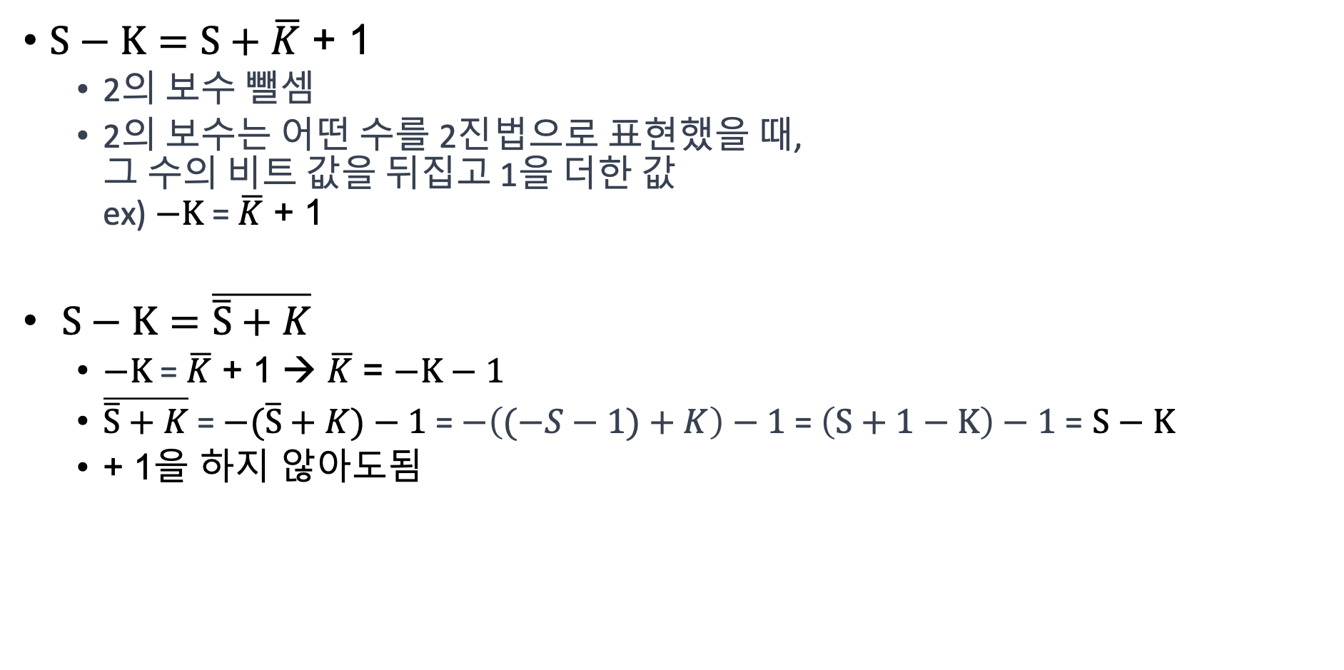
$$\text{Step}\text{ 1 :}S−K$$
$S−K=S+\overline{K}$ + 1
2의 보수 뺄셈
2의 보수는 어떤 수를 2진법으로 표현했을 때, 그 수의 비트 값을 뒤집고 1을 더한 값 ex) $−K$ = $\overline{K}$ + 1
$S−K=\overline{\overline{S}+K}$
$−K$ = $\overline{K}$ + 1 → $\overline{K}$ = $−K−1$
$\overline{\overline{S}+K}$ = $−(\overline{S}+K)−1$ = $−\left((−S−1)+K\right)−1$ = $\left(S+1−K\right)−1$ = $S−K$
+ 1을 하지 않아도됨

Slide 7
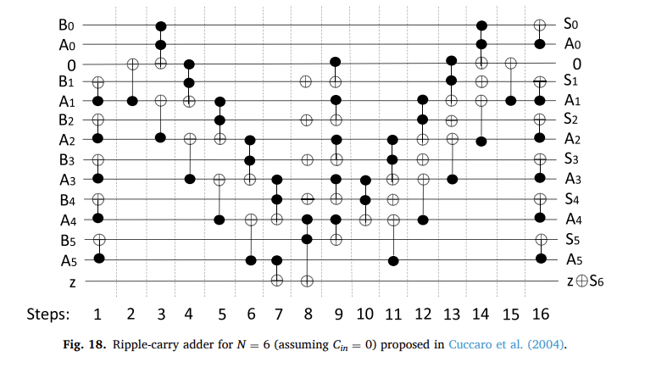
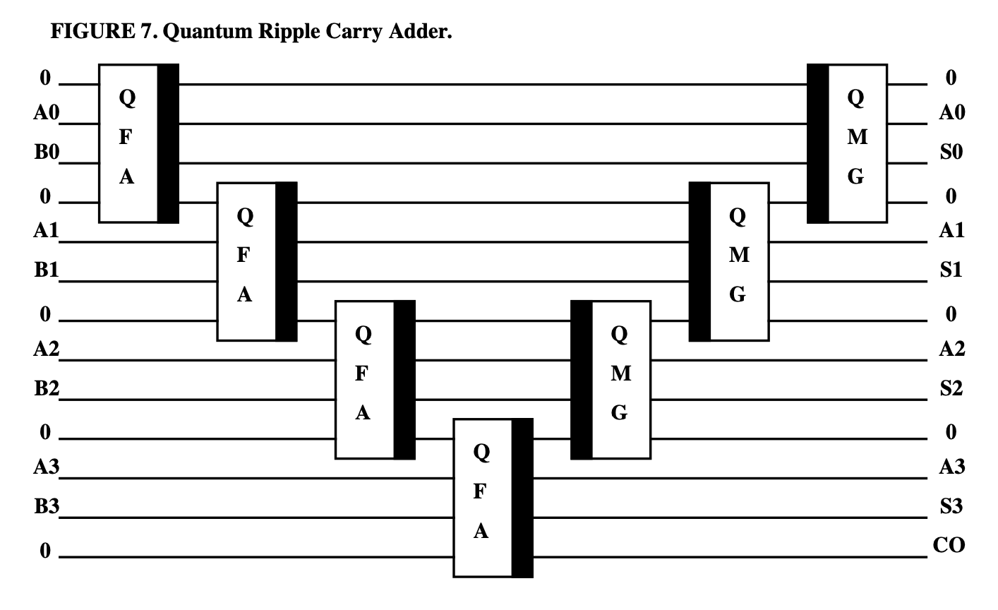
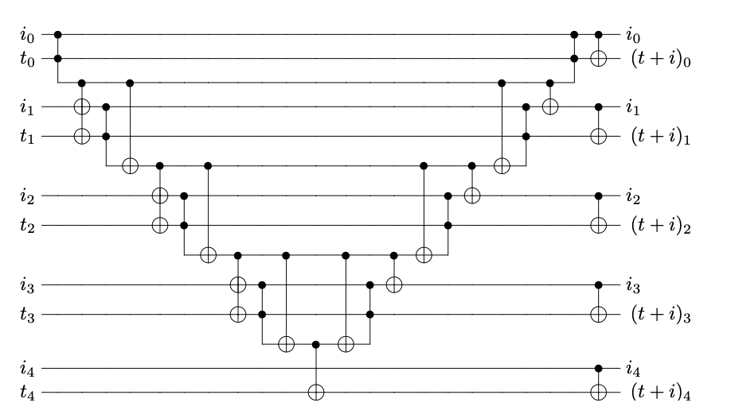
Quantum Ripple Carry Adder

Slide 8
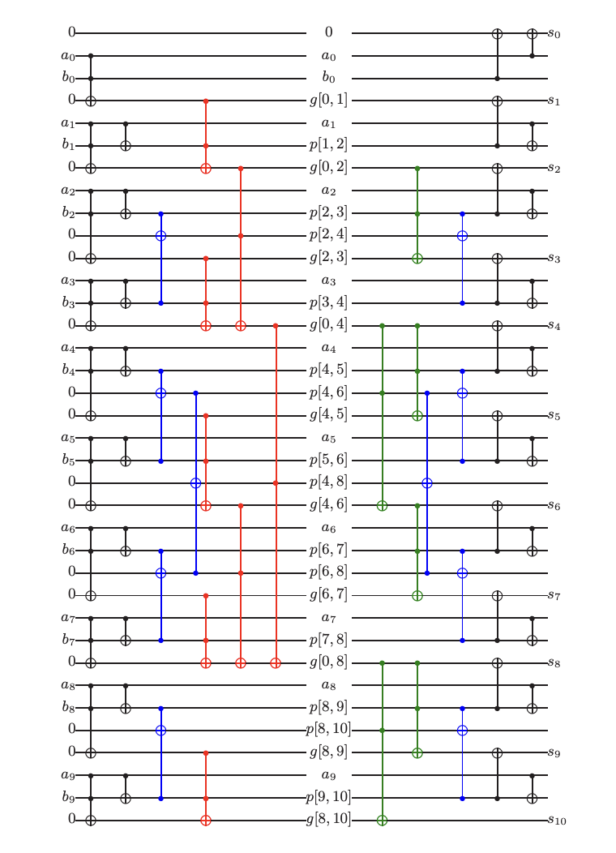
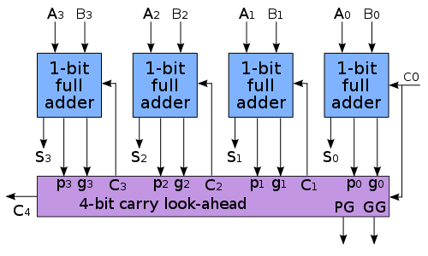
Carry-lookahead adder

Slide 9
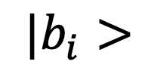
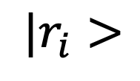
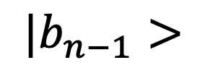

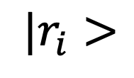

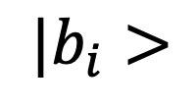

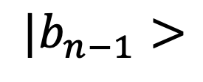

$\text{Step}\text{ 2 :} Max(S−K,0)$
IF (S-K is negative)
$b_{n−1}$ is 1
$r=0$
$$|r_{i}>$$
$$⨁$$
$$|r_{i}>$$
$${|b}_{i}>$$
$${|b}_{i}>$$
else
$b_{n−1}$ is 0
$r=b$ = S-K
$|b_{n−1}$ $>$
$$⨁$$
$|b_{n−1}$ $>$

Slide 10
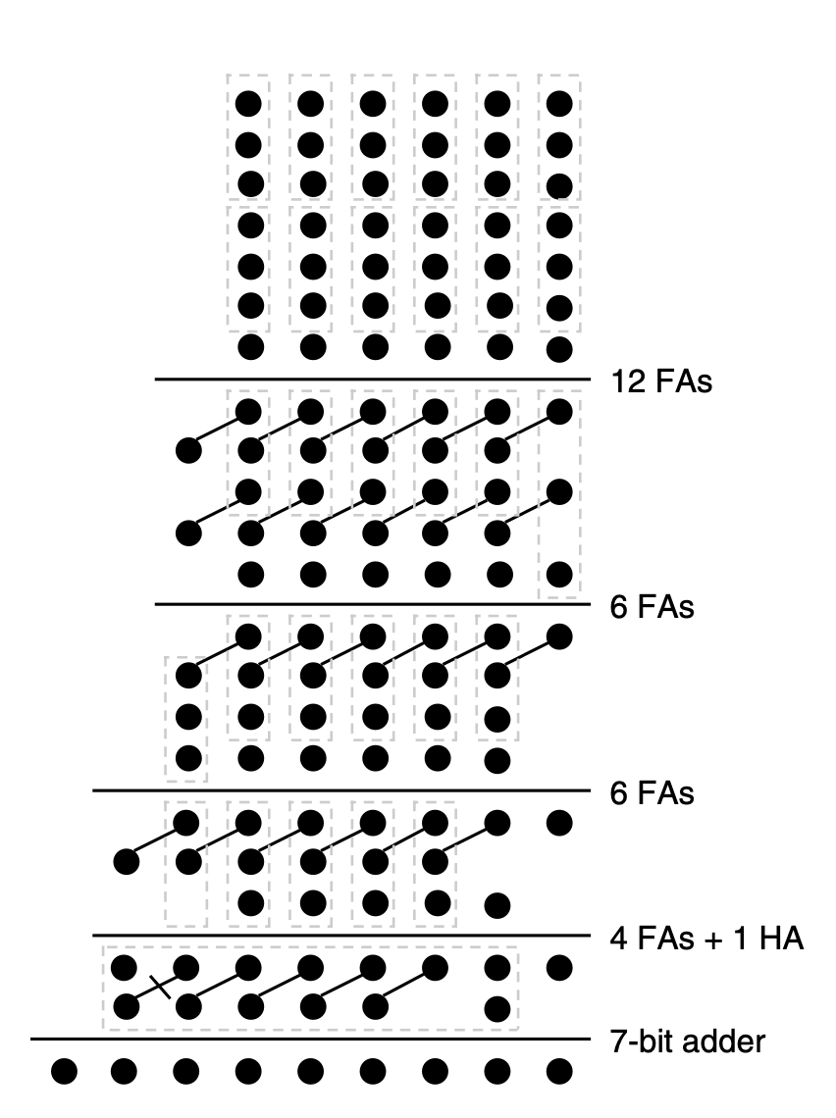
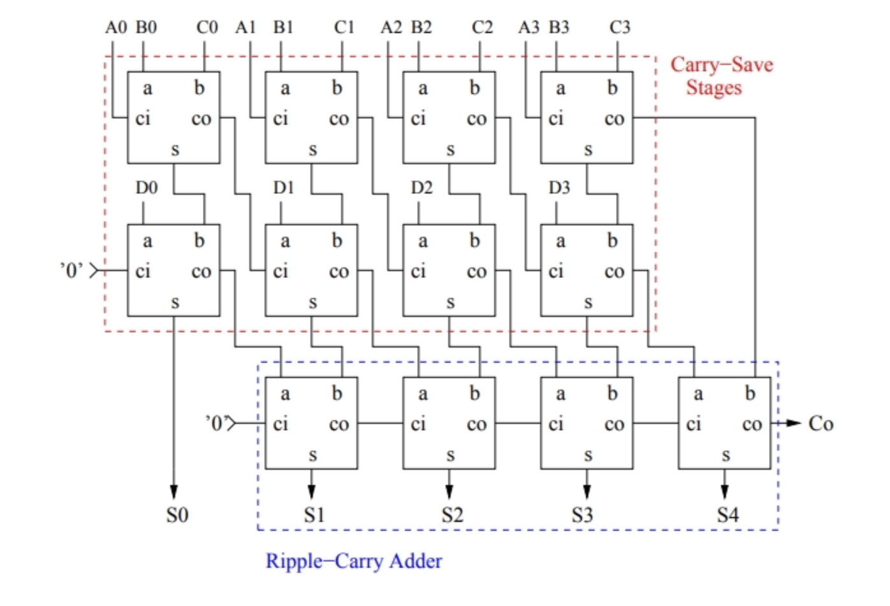
Carry-save Adder: Generic arithmetic
이진법에서 3개 그이상의 n 비트수 덧셈을 계산하기위한 컴퓨터 기본설계에 사용하는 가산기의 한 종류
A+B+C+D

Slide 11
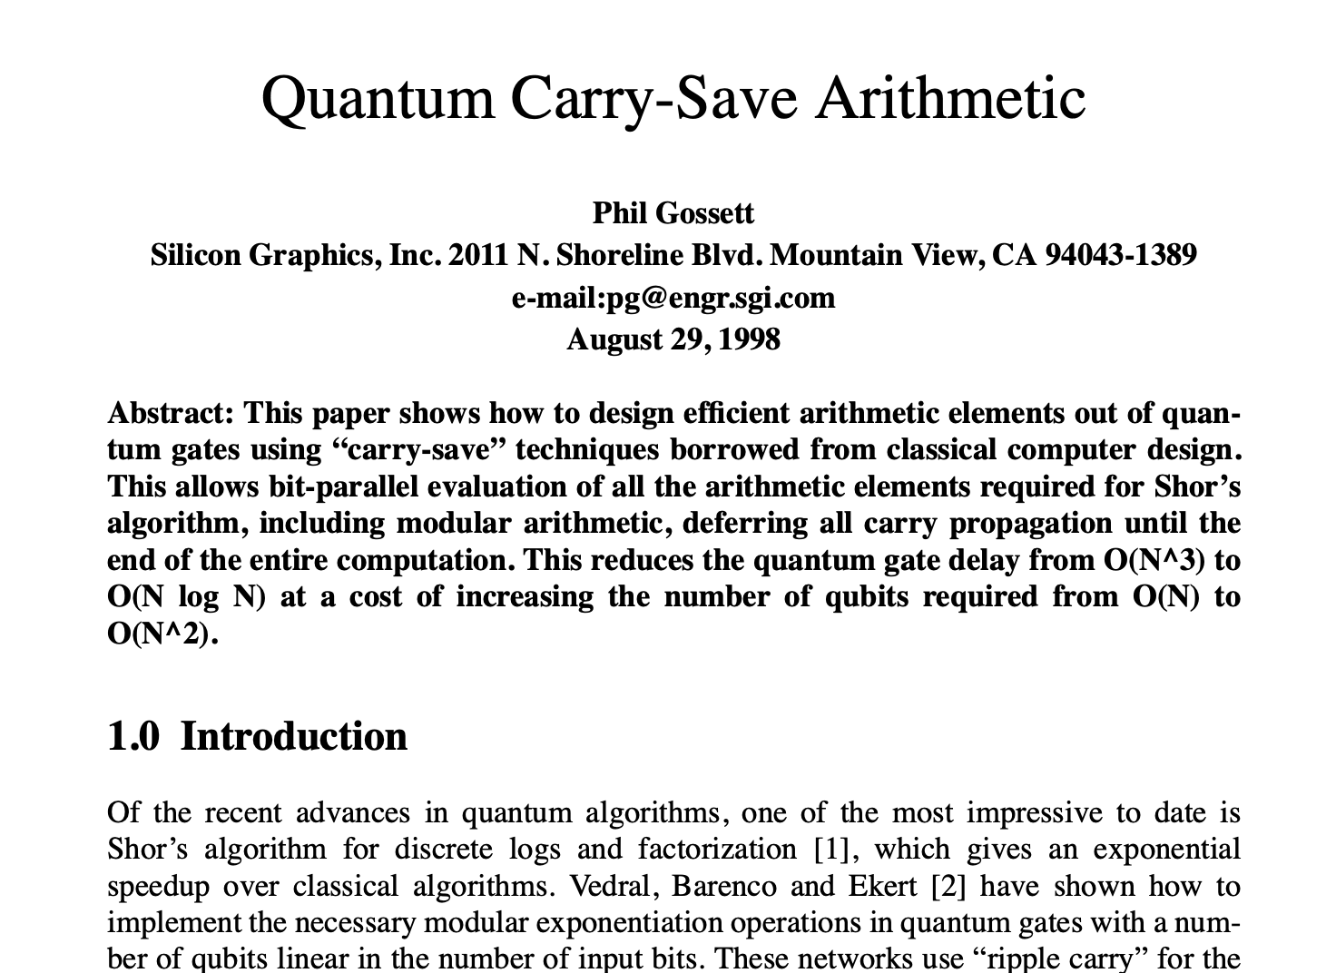
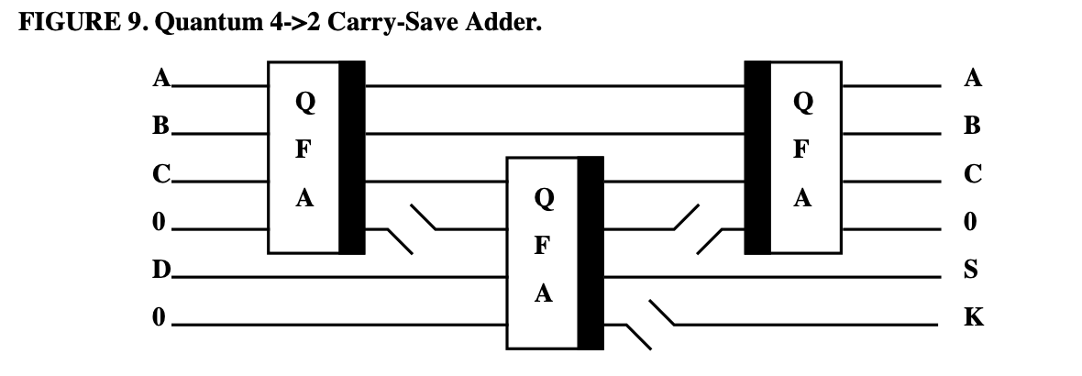
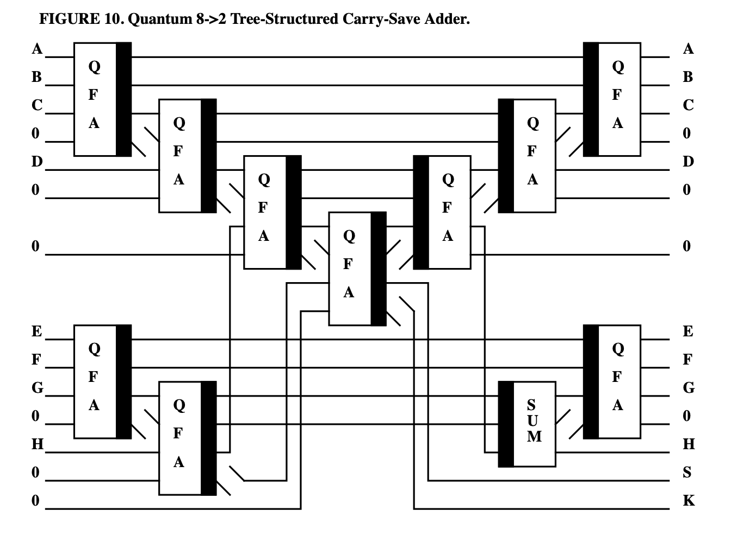
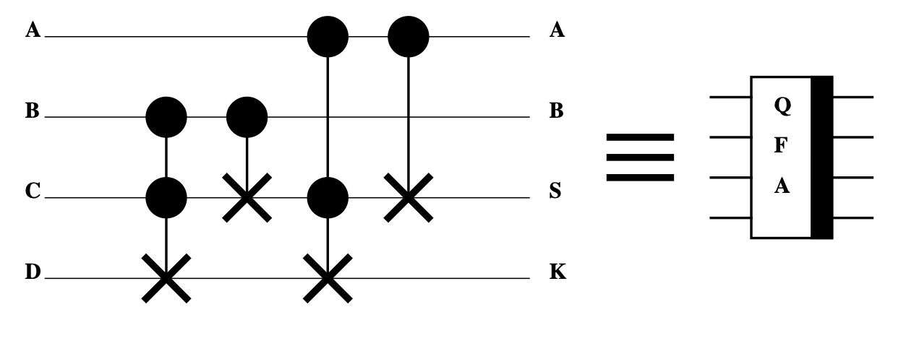
Carry-save Adder: Generic arithmetic

Slide 12
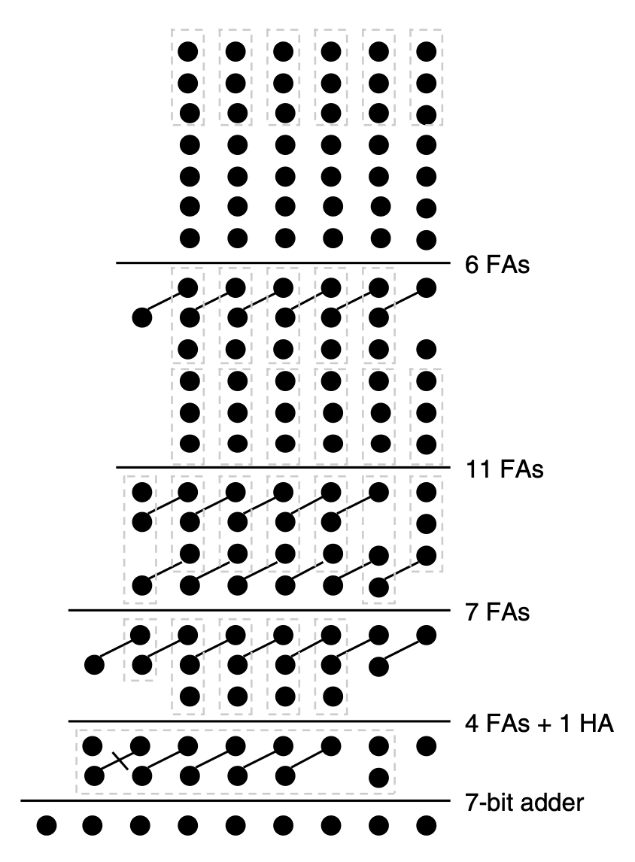
WALLACE and DADDA TREES

